Slide 1


Introduction to Big Data
Associate Professor
Department of Computer Science and Engineering

Slide 2
Session Objectives
Big Data Definition
Big Data Types
Big Data Architectures
Big Data Warehousing

Slide 3
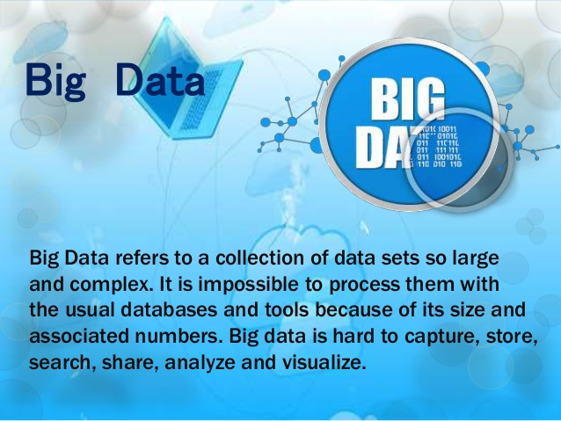

Slide 4
Importance of Big Data
Cost Reductions
Time Reductions
New product development and optimize offerings.
Smart Decision Making

Slide 5
Big Data
A term for any collection of large and complex data sets.
It is difficult to process using database management tools or traditional data processing applications.
The challenges include capture, refining, storage, search, sharing, transfer, analysis and visualization.
Most companies collect ‘millions’ of data items. Many more are available via Google, Facebook, Twitter, Amazon, etc.
These data are seldom structured.
Many companies use “Big Data” for manual queries (marketing and sales), to answer research questions etc.
It is still not common to utilize Big Data automatically and systematically within an algorithmic (forecasting) framework.
We argue that such use will both contribute to both the analysis and to the forecasting.

Slide 6
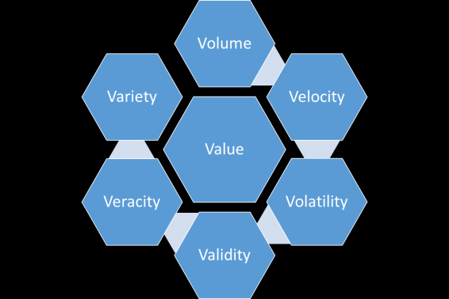
Big Data Types: 7 V s

Slide 7
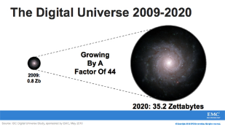
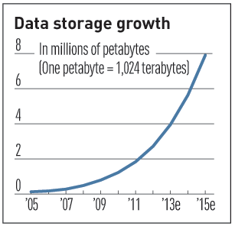

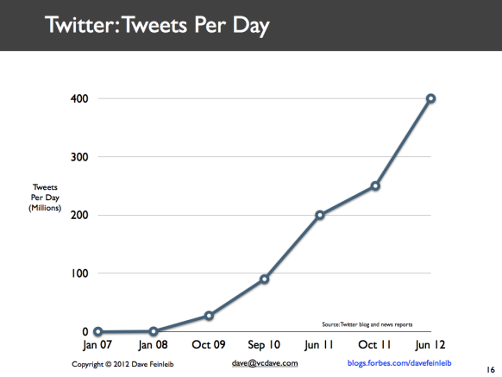
Volume: -Big data implies enormous volumes of data -How much data is really relevant to the problem solution? -Cost of processing? -So, can you really afford to store and process all that data?
Data Volume
44x increase from 2009 - 2020
From 0.8 zettabytes to 35zb
Data volume is increasing exponentially
Exponential increase in collected/generated data

Slide 8
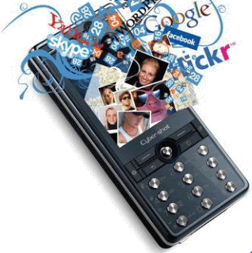


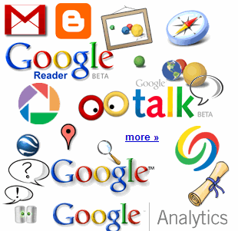

Volume: Example
4.6 billion camera phones world wide
30 billion RFID tags today (1.3B in 2005)
12+ TBs of tweet data every day
100s of millions of GPS enabled devices sold annually
? TBs of data every day
25+ TBs of log data every day
2+ billion people on the Web by end 2011
76 million smart meters in 2009… 200M by 2014

Slide 9
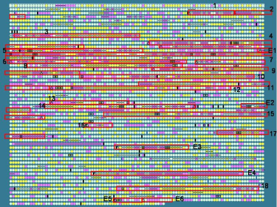
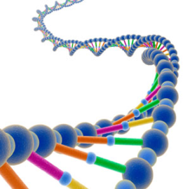
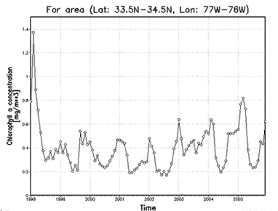

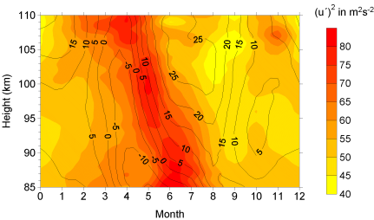
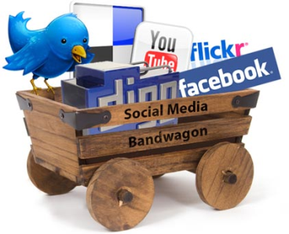
Variety: -Variety refers to the many sources and types of data both structured and unstructured. -A small fraction is structured formats, Relational, XML, etc. -A fair amount is semi-structured, as web logs, etc. -The rest of the data is unstructured text, photographs, etc. -So, no single data model can currently handle the diversity
Different Types of Data
Relational Data (Tables/Transaction/Legacy Data)
Text Data (Web)
Semi-structured Data (XML)
Graph Data
Social Network, Semantic Web (RDF), …
Streaming Data
You can only scan the data once
A single application can be generating/collecting many types of data
Big Public Data (online, weather, finance, etc)
To extract knowledge➔ all these types of data need to linked together

Slide 10
















Veracity:
-Big Data Veracity refers to the biases, noise and abnormality in data.
-Is the data that is being stored, and mined meaningful to the problem being analyzed.
-Accuracy, Precision, Reliability, Integrity
-So, what is it that you don’t know you don’t know about the data?
Social Media
Banking
Finance
Gaming
Customer
Our
Known
History
Entertain
Purchase

Slide 11

Big Data Velocity deals with the pace at which data flows in from sources like business processes, machines, networks and human interaction with things like social media sites, mobile devices, etc. - The flow of data is massive and continuous. - Need for streaming for data analysis - So, how to analyze data in-flight and combine with data at-rest
Velocity:
Data is being generated fast and need to be processed fast
Online Data Analytics
Late decisions ➔ missing opportunities
Examples
Pizza ordering and processing
Zomatto Servicing
Healthcare monitoring: sensors monitoring your activities and body ➔ any abnormal measurements require immediate reaction

Slide 12
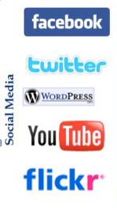
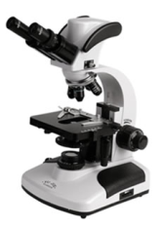
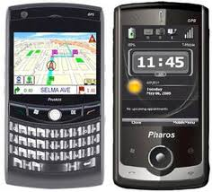
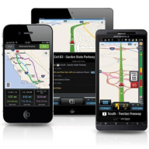
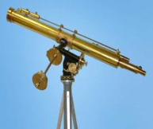

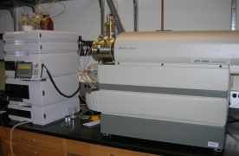
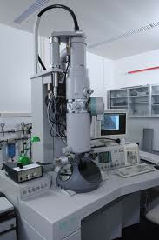
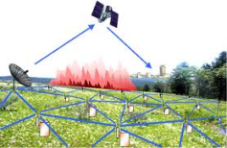

Example: Real-time/Fast Data
Mobile devices
(tracking all objects all the time)
Social media and networks
(all of us are generating data)
Scientific instruments
(collecting all sorts of data)
Sensor technology and networks
(measuring all kinds of data)
The progress and innovation is no longer hindered by the ability to collect data
But, by the ability to manage, analyze, summarize, visualize, and discover knowledge from the collected data in a timely manner and in a scalable fashion

Slide 13
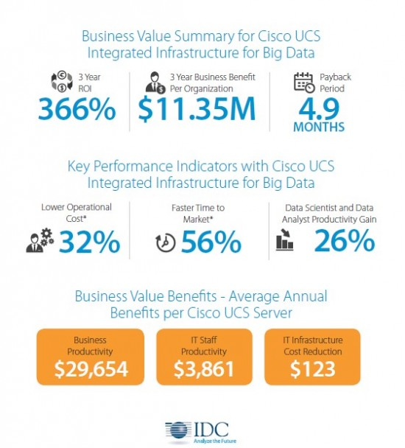
Value:
- How much value is created for each unit of data (whatever it is)? - So, what is the contribution of subsets of the data to the problem solution?

Slide 14
Validity:
- The data correct and accurate for the intended use. - Valid data is key to making the right decisions. - How to validate the data for accuracy?
Product
Recommendations
that are Relevant
& Compelling
Learning why Customers
Switch to competitors
and their offers; in
time to Counter
Influence
Behavior
Improving the
Marketing
Effectiveness of a
Promotion while it
is still in Play
Customer
Friend Invitations
to join a
Game or Activity
that expands
business
Preventing Fraud
as it is Occurring
& preventing more
proactively
Real-Time Analytics/Decision Requirement

Slide 15
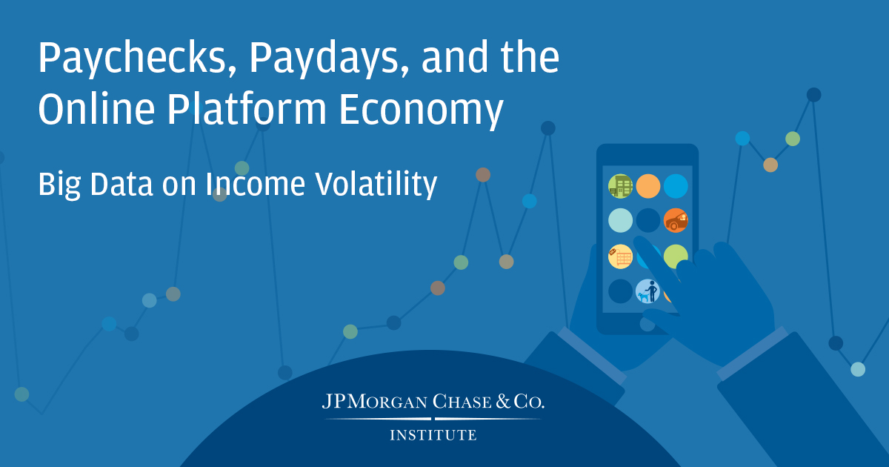
Volatility:
-Big data volatility refers to how long is data valid and how long should it be stored.
-Real time data you need to determine at what point is data no longer relevant to the current analysis.
-Decision on to how long keep the data?

Slide 16
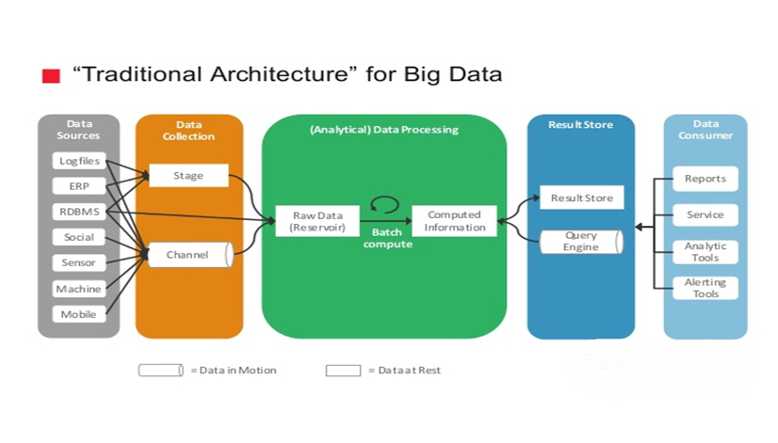
Traditional Big Data Architecture

Slide 17
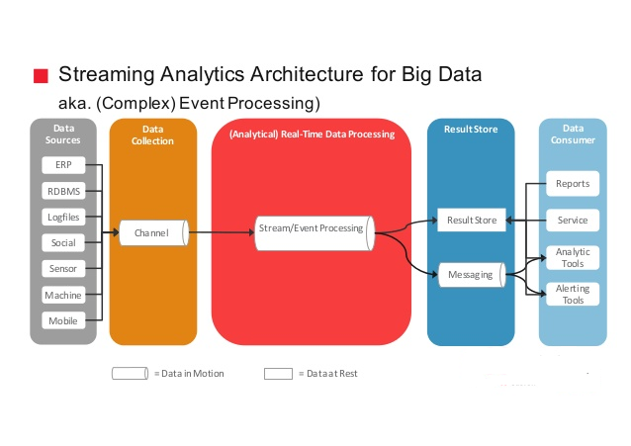
Streaming Big Data Architecture

Slide 18
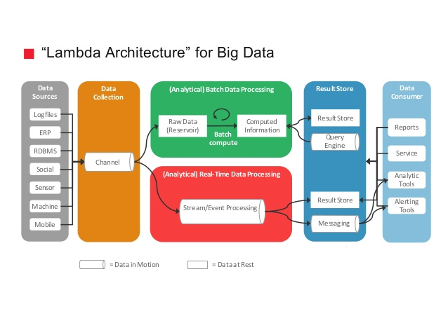
Lambda Big Data Architecture

Slide 19
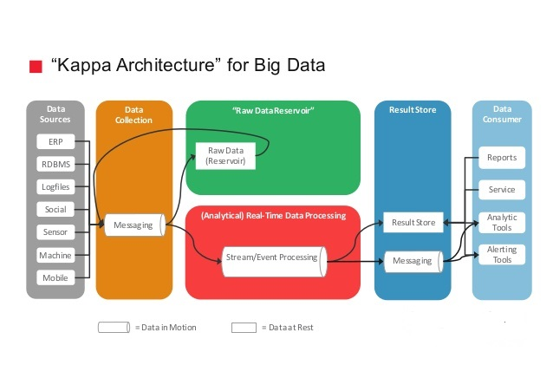
Kappa Big Data Architecture

Slide 20
Limitation of Big Data
Prioritizing correlations
Data analysts use big data to tease out correlation: when one variable is linked to another.
However, not all these correlations are substantial or meaningful.
More specifically, just because 2 variables are correlated or linked doesn’t mean that a relationship exists between them.
Security
As with many technological endeavors, big data analytics is prone to data breach.
The information that you provide a third party could get leaked to customers or competitors.

Slide 21
Limitation of Big Data
Transferability
Because much of the data you need analyzed lies behind a firewall or on a private cloud, it takes technical know-how to efficiently get this data to an analytics team.
Furthermore, it may be difficult to consistently transfer data to specialists for repeat analysis.
Inconsistency in data collection
Sometimes the tools we use to gather big data sets are not certain.
For example, Google is famous for its tweaks and updates; the results of a search on one day will likely be different from those on another day.
Hence, if using Google search to generate data sets then the correlations would change as the data changes.

Slide 22
Summary
Define Big Data
Big Data Types
Big Data Analysis Architecture

Slide 23
Thanks

